Slide 1

DR KOTTNIS HOSPITAL APP
PRESENTED BY
MUHAMMAD AHSAN ALI
MUHAMMAD JAWAD

Slide 2


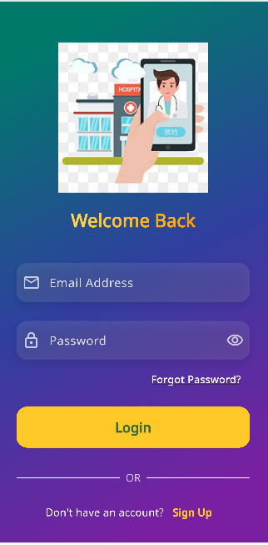
Dr Kottnis Hospital
Kottnis was a indian Person .He was a Doctor.He serve the peoples of china and india in world war 2 .He was the Heros of both Countries
DKH

Slide 3
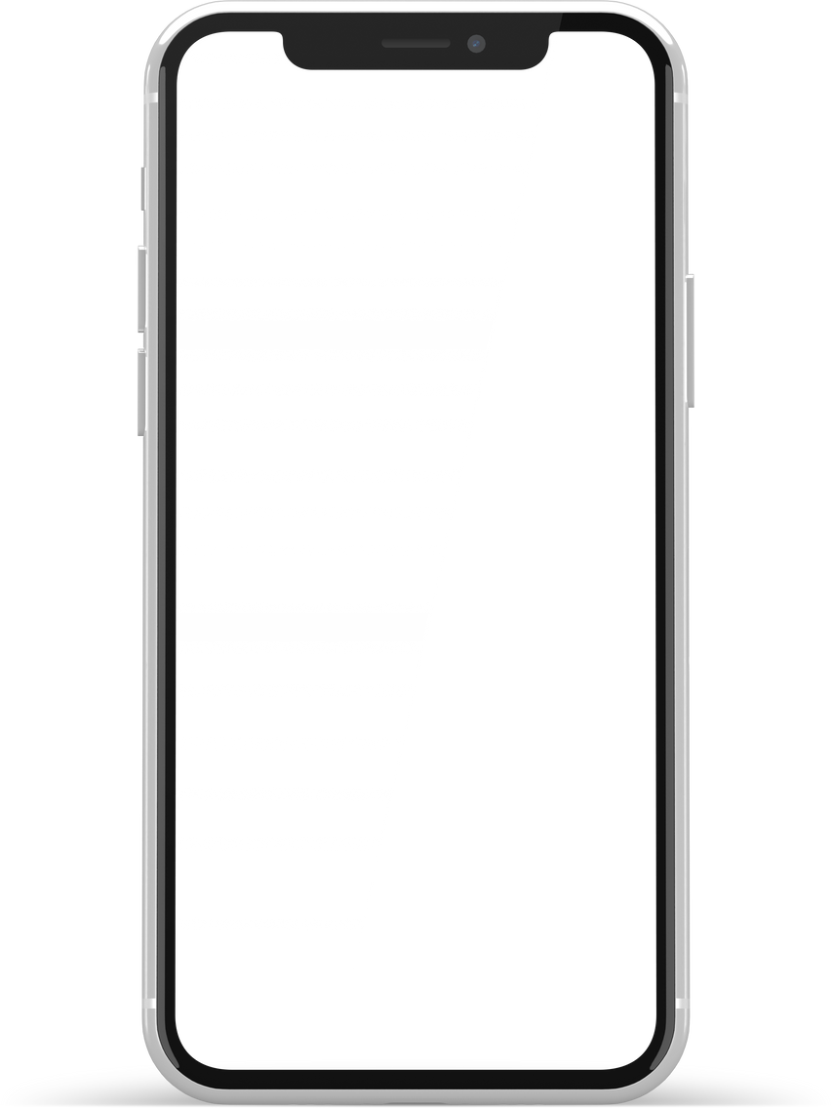
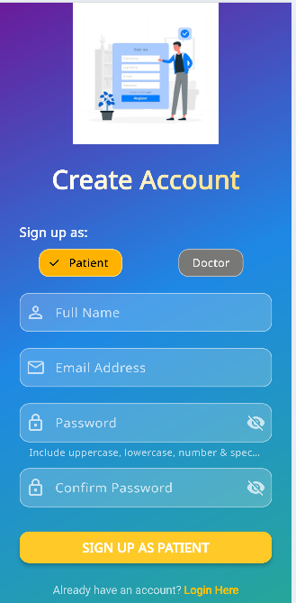
Dr Kottnis Hospital
Sign Up AS A Patient
Patient can sign up by using their valid email
DKH

Slide 4
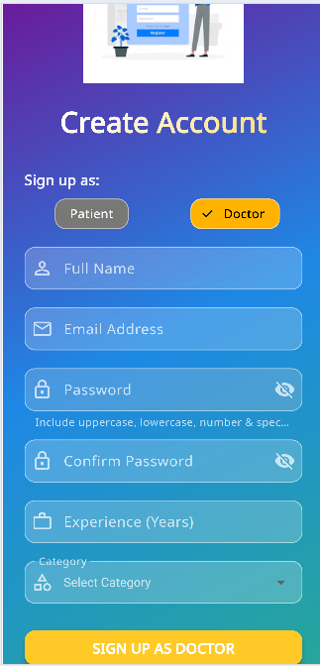
Dr Kottnis Hospital
Sign Up AS A Docttor
Doctor can sign up by using their valid email
DKH

Slide 5
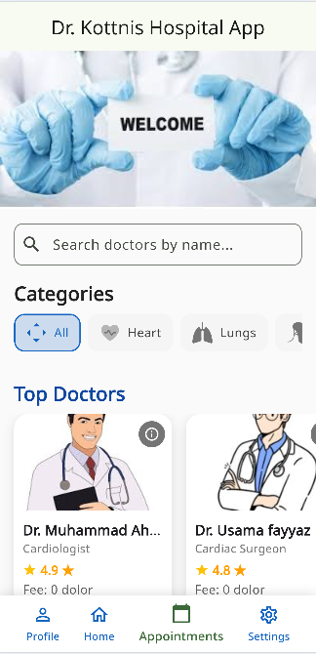
Dr Kottnis Hospital
Patient home Screen where Pateint seen doctors and Book Appointment
DKH

Slide 6
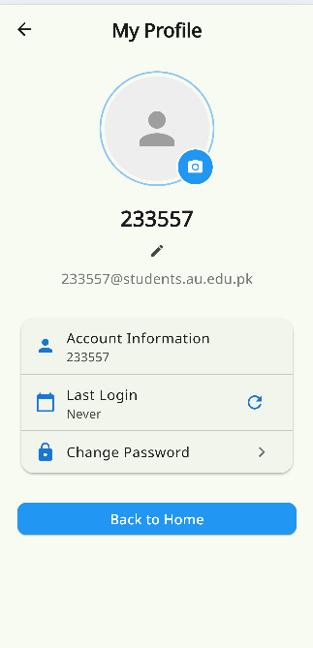
Dr Kottnis Hospital
Patient Profile
DKH

Slide 7
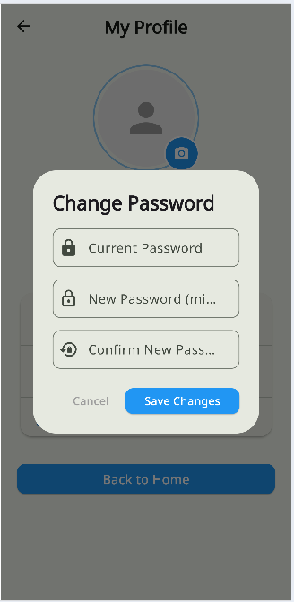
Dr Kottnis Hospital
Change password of Profile
DKH

Slide 8
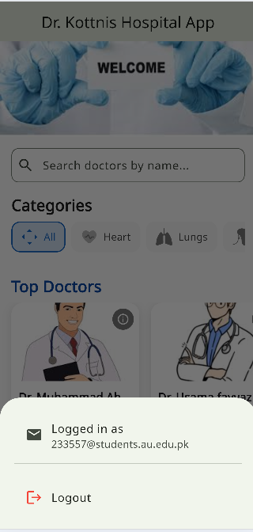
Dr Kottnis Hospital
Patient Log out
DKH

Slide 9
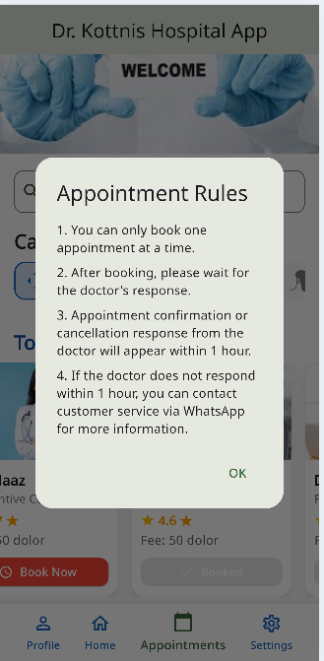
Dr Kottnis Hospital
Appointment Rules For Patient
DKH

Slide 10
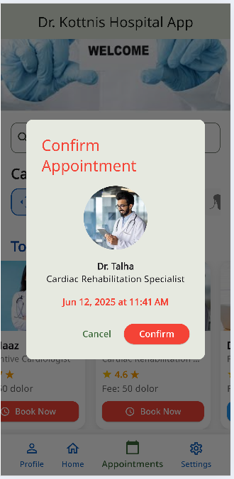
Dr Kottnis Hospital
Booked Appointment By Patient
DKH

Slide 11
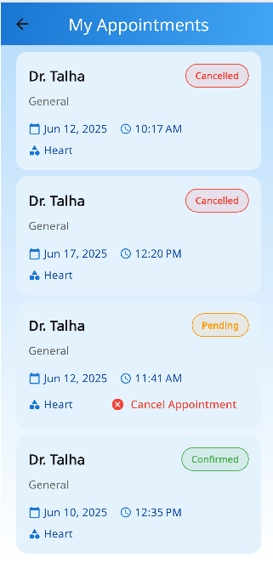
Dr Kottnis Hospital
Patient Appointments History
DKH

Slide 12
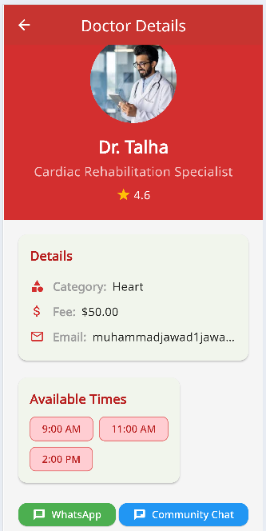
Dr Kottnis Hospital
Doctors Details
DKH

Slide 13
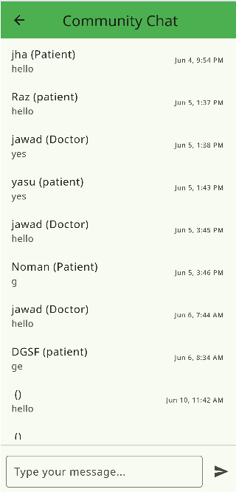
Dr Kottnis Hospital
Community Chat
DKH

Slide 14
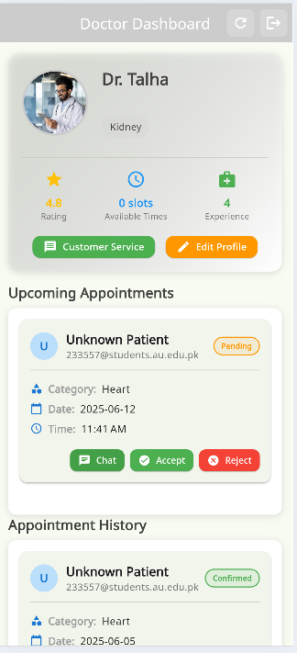
Dr Kottnis Hospital
Doctor Dashboard
DKH

Slide 15
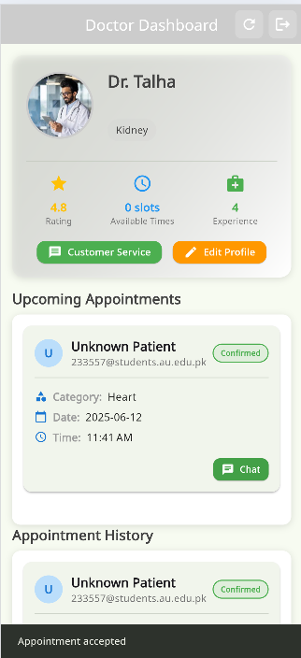
Dr Kottnis Hospital
Doctor Confirm Appointment
DKH

Slide 16
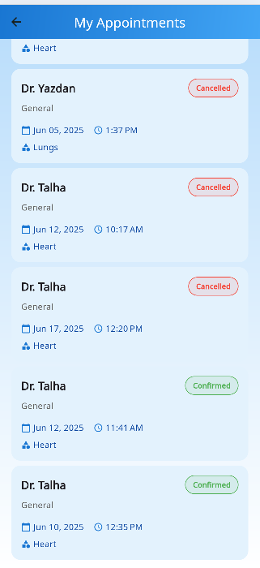
Dr Kottnis Hospital
Cancelled/Confirmed Appointments
DKH

Slide 17
Thank you very much!

